Slide 1


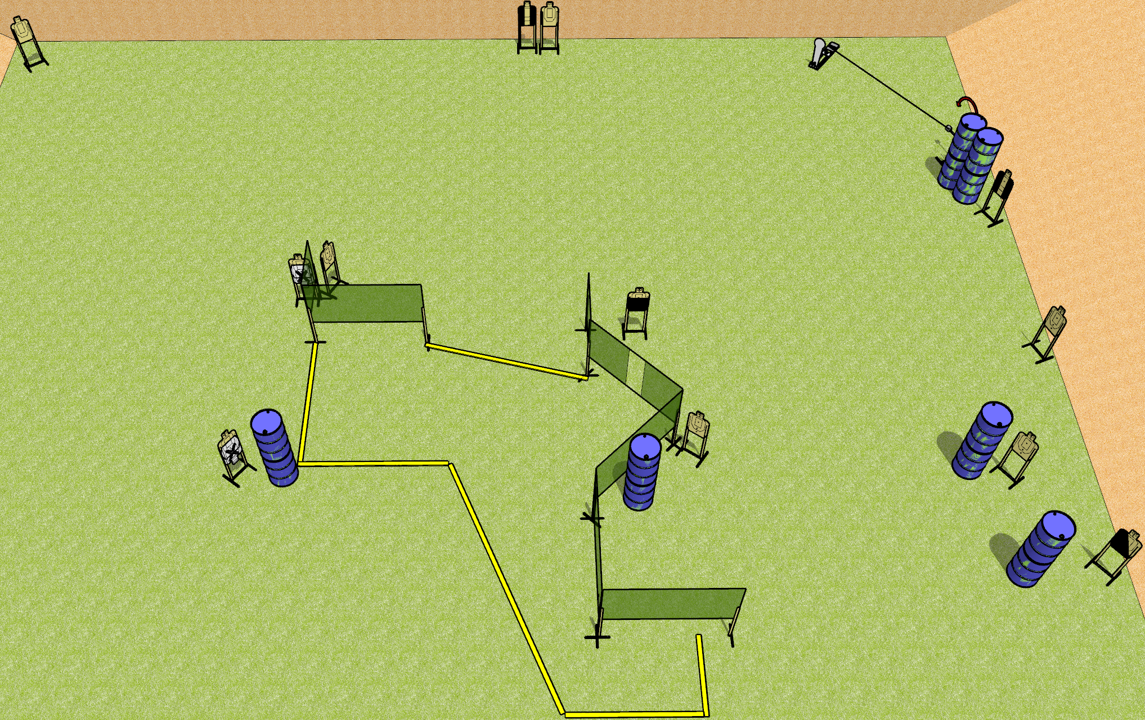
 | Dothan Gun Club – USPSA Match Low Go Course Designer : Drew Coleman
Round Count 25 rounds 12 USPSA 1 Colt popper
Equipment List 11 wall feet 1 medium fault line Swinger + activator 1 50%, 2 tux, 1 left diag

Slide 2
Low Go
Written Stage Briefing
Low Go is a 25 round, 125 point, Comstock course of fire. There are 12 USPSA targets and 1 colt popper. The best 2 hits on paper will score, and steel must fall to score. The start signal is audible.
The swinger is activated by the colt popper and remains visible at rest.
Handgun start position is anywhere completely outside the shooting area, wrists below belt. Handgun is loaded and holstered.
PCC start position is anywhere completely outside the shooting area, stock on belt. Loaded carbine is held with both hands, safety on.
On start signal, engage targets as they become available from within the shooting area.

